Slide 1
Forecasting Module for Revenue Management Using Artificial Intelligence Techniques for SM Hotels and Conventions
Katelyn Calma
Jim Castillo
Eugene Delfin
Shania Reyes
Kaila Roguel

Slide 2
Project Context
Manually forecast data
Forecast by guesswork
Forecasting module using AI techniques

Slide 3
Purpose and Description
Forecast revenue management tool
Three performance indicators
Artificial intelligence techniques
A more accurate forecast

Slide 4
Objectives
General Objective
create a Forecasting Module for Revenue Management using artificial intelligence
Specific Objective
Automate analysis and generation of reports
Export an excel file
Project forecast within ±5%
To be able to forecast more accurately

Slide 5
Scope and Limitation
Generate forecasts for Room Segmentation Report and Flash Report
Revenue management system
Automate room segmentation and flash reports
Compute and forecast
Room revenue generating department
Data will be imported into the system

Slide 6
Gap-Impact Analysis

Slide 7
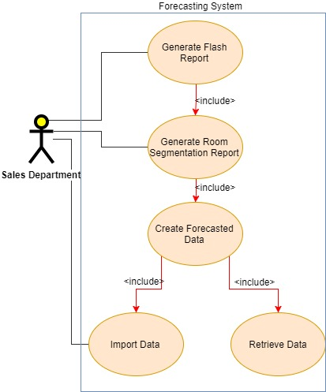
Use Case Diagram

Slide 8
Description of Prototype
A web-based system
CRUD of tables in the database
Can import and export excel files
Contains a dashboard
Requires user to login

